Slide 1
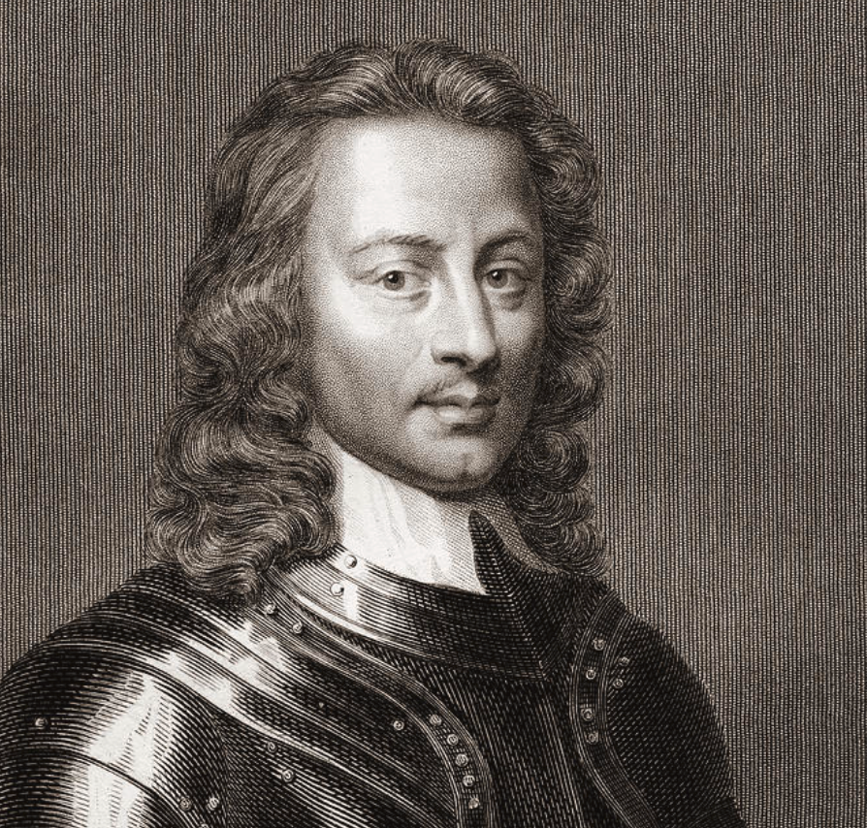

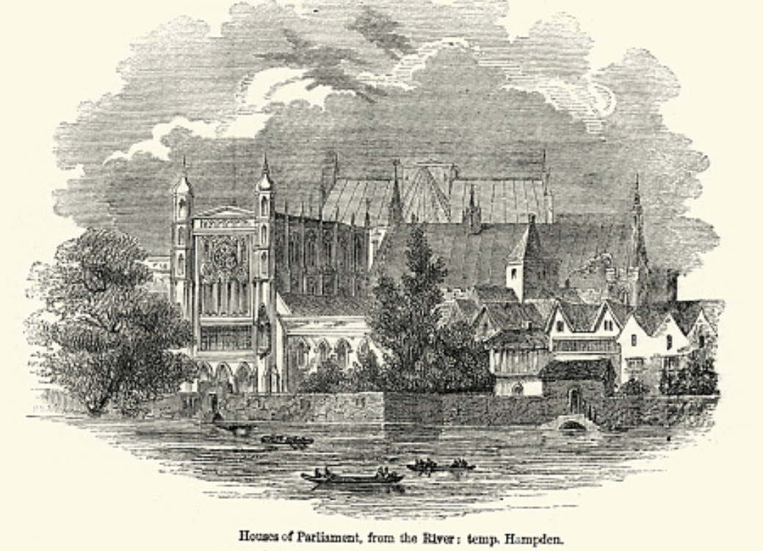
Lecture: North Atlantic Political Economy: 1870-1914
Political economy before the 1870s:
From “Divine Right” and “Natural Order” to Enlightenment values…
Who was the first person to draft these words?:
“We hold these truths… sacred & undeniable: that all men are created equal & independant, that from that equal creation they derive rights inherent & inalienable, among which are the preservation of life, & liberty, & the pursuit of happiness; that to secure these ends, governments are instituted among men, deriving their just powers from the consent of the governed…”
Why did he write them?
1:15 of audio in this slide; 12:45 in this slide group
Notes:
Let’s talk about political economy in the global north before 1870.
First, let’s talk about ideas about good government:
Things evolved: From “Divine Right” and “Natural Order” to Enlightenment values…
Here are some famous words:
> “We hold these truths… sacred & undeniable: that all men are created equal & independant, that from that equal creation they derive rights inherent & inalienable, among which are the preservation of life, & liberty, & the pursuit of happiness; that to secure these ends, governments are instituted among men, deriving their just powers from the consent of the governed…”
Who was the first person to write them?
And why did he write them?
Yes, this is Thomas Jefferson. That it is not the government that is instituted by God or the gods and has his or their blessing but, rather, the rights of individuals—and that the legitimate government with rightful powers has only the powers that people consent to give it. That was still a relatively new idea in 1870, even though it had then been roiling North Atlantic politics for a century and a quarter.
But to what sort of government should people give their consent?

Slide 2
Why Was the Proper Political Order?
What was the proper political order?:
Fears of “democracy” among American founders:
Madison: “Democracies have ever been spectacles of turbulence and contention... incompatible with personal security or the rights of property... as short in their lives as... violent in their deaths…”
Jefferson: “Gen’l Washington had not a firm confidence in the durability of our government… [& this] had some weight in his adoption of… ceremonies… calculated to prepare us gradually for a change which he believed possible…”
Question of political order thought settled: first in the rubble of Berlin in 1945, and then in the streets of East Germany in 1991, in favor of representative democracy, private property, & social insurance—late-1900s liberal democracy.
But now reopened? Min Zhu (朱民) to me in 2015: “What are you Americans going to do to fix your broken political system?”
2:30 of audio in this slide
Notes:
What was the proper political order that the people should vote for when they ratified their constitutions?
In the late 1700s James Madison had not been enthusiastic about democracy:
>”Democracies have ever been spectacles of turbulence and contention... incompatible with personal security or the rights of property... as short in their lives as... violent in their deaths…”
Next to nobody was enthusiastic about democracy back in the late 1700s.
James Madison had been enthusiastic about a republic.
People who counted were to choose a small, select group of representatives who had their values and well-being at heart, but not their passions or their interests. Representatives would then govern subject to procedural checks-and-balances. Under Madison and company’s America constitution, remember, states could restrict the franchise as much as they wished—as long as it preserved “a republican form of government.”
James Madison’s suspicions had been widely shared.
His one-time friend and co-author Alexander Hamilton even held that a constitutional monarchy—in which the monarch, the aristocracy, and the masses all held real power to balance one another—was the best of all attainable governments.
Now when the long 20th century began these questions were on the point of being settled. One person, one vote was on the march. That the legitimate government was one in which the majority ruled through its elected representatives who carried out its will, while protecting minority rights, was being settled. It was, we thought, finally settled in the rubble of Berlin in 1945, and then in the streets of East Germany in 1991, in favor of representative democracy, private property, & social insurance—late-1900s liberal democracy.
Now perhaps, these questions are reopened again. As senior Chinese Communist Party official and IMF honcho Min Zhu (朱民) said to me in 2015: “What are you Americans going to do to fix your broken political system?” And that was before 2016—let alone 2020.

Slide 3
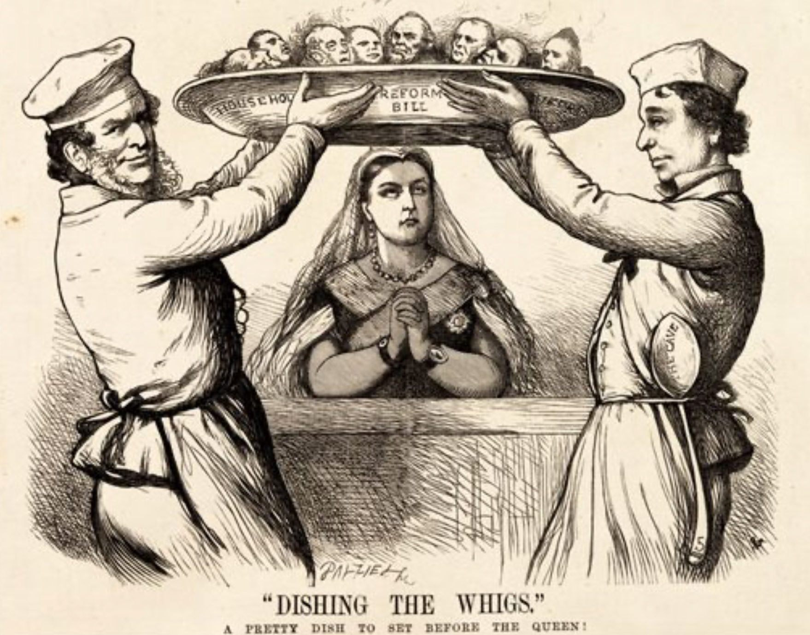
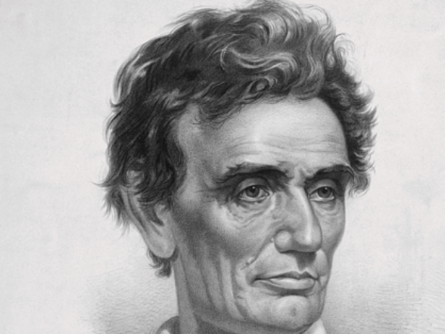
Franchise Extension & Promises of Opportunity
Dynamic of extension:
Liberals in power would try extend on the principle that the new, poorer voters would be less conservative…
Conservatives in power would seek to extend the franchise in order to peel off those of the disenfranchised who had the most social power from any radical movement…
Earl Grey (yes, the tea): “The Principal… is to prevent… revolution…. I am reforming to preserve, not to overthrow…”
“We must educate our masters”
The race line
American opportunity as of 1840:
Abraham Lincoln: “The prudent, penniless beginner… saves a surplus… and at length hires another new beginner to help him…”
Lincoln: “It that it is best for all to leave each man free to acquire… [and] get wealthy…”
4:45 of audio in this slide
Notes:
As the 1800s moved forward and turned into the 1900s, democracy—at least in the form of one male of the right age and race, one vote—as the touchstone of political legitimacy made massive strides, if at deliberate speed.
Claims that kings ruled by divine right and that aristocracies ruled by virtue of their ancestors having been among those who conquered the Anglo-Saxons with William of Normandy or the Romano-Gauls with Clovis the Frank became increasingly risible and ran aground. So many aristocrats were noble because their ancestors had been fixers, pimps, or bureaucrats for past kings.
For a while prosperity was an alternative touchstone: rulers should be elected or at least advised by those selected by vote, yes, but by a vote of the prosperous. Up until the end of World War I, in the Prussian provincial legislature of the German Empire, those who paid the top 1/3 of taxes got to elect one third of the representatives. François Guizot, left-of-center Prime Minister of France’s constitutional monarchy in the early 1840s, responded to demands for a broader electoral franchise with the words enrichessez vous: if you want to vote, get rich enough that you qualify. It did not work. On February 23, 1848, King Louis-Philippe of France’s Orleanist dynasty—the only king of the Orleanist dynasty—threw Guizot over the side, in the hope of avoiding revolution and dethronement. Louis Philippe abdicated the following day.
Worldwide, politicians on the left wanted, eventually, more than one person-one vote. They sought the abolition of private property and the rational distribution of the products of the societal division of labor… well, by it was not clear what. They sought guarantees that the people would elect representatives who were strong advocates of some form of socialism, and were obedient members and tools of a “party of a new type”, as Lenin put it.
But that position was not accepted by the bulk of political society: only rarely could it win any majorities for its position that the government should have a totalizing role—that all questions should be settled and all social life organized by a government, in which each one counted for one and one alone, and in which electorates were properly guided to trust the party that possessed the ideology that was the key to the riddle of history.
Worldwide, politicians on the right held the view that some existing inequalities of wealth, influence, and political weight were just or holy or both. But they were divided. Some viewed inequalities emerging from the creative destruction and accumulation of the market with, at best, suspicion. Others viewed inherited and status inequalities with grave suspicion. Some tried to to reconcile and exalt all the groups of inheritors, entrepreneurs, and crony capitalists, but that was a difficult balancing act.
Thus the balance point was in the middle.
Over 1870-1913 the political principle that caused the least offense to the greatest number was that political society would be a realm in which some or most of the male individuals’ preferences counted equally in choosing the government, and that the government would then curb and control the economy, to limit but not extinguish the extra influence of those whom American Republican President Theodore Roosevelt called the “malefactors of great wealth” and others called the “insdustrial statesmen” early in the 1900s.
Franchise extension halted for a while at the patriarchy line: for varying lengths of time universal suffrage was universal male suffrage. Extension of the franchise often halted quite a while at the race line, especially in the United States.
The countrywide enfranchisement of African-Americans had to wait until after 1965. Even today, one-third of American states have recently crafted bureaucratic and legal obstacles in the hopes of differentially disenfranchising up to one-fourth of African-American voters. The late Supreme Court Chief Justice William Rehnquist won his spurs by running “ballot security” efforts in which:
>every Black or Mexican[-looking] person was being challenged… [as] a deliberate effort to slow down the voting… to cause people waiting their turn to vote to grow tired… and leave…. Handbills were distributed warning persons that if they were not properly qualified to vote they would be prosecuted…
This was not thought to disqualify Rehnquist from becoming Chief Justice of the Supreme Court, a job Ronald Reagan appointed him to. This was not thought to disqualify Rehnquist from polite society. Or from deciding the 2000 presidential election in favor of George W. Bush over Al Gore.

Slide 4
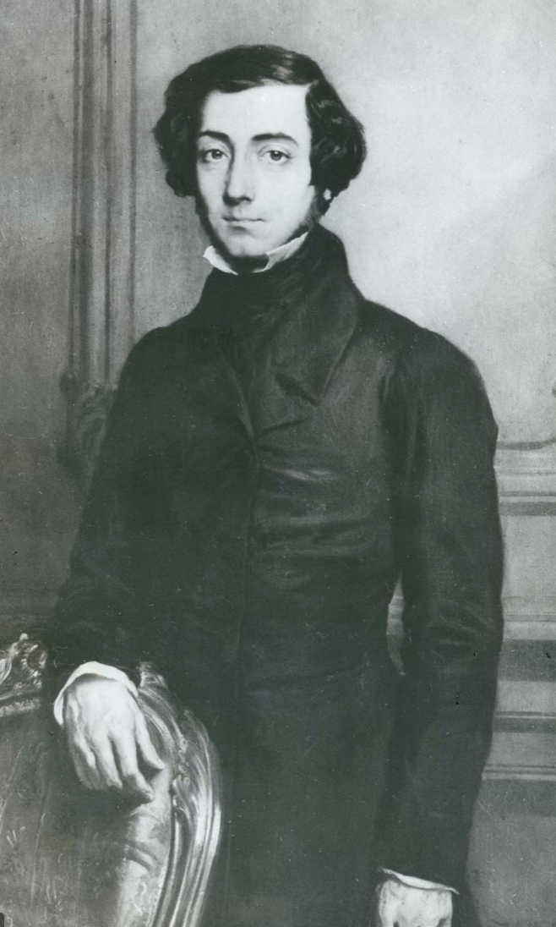
But Where, in 1900, Was the Opportunity?
America’s “aristocracy of manufactures”:
Tocqueville: “The territorial aristocracy of past ages… [was] obliged… to come to the help of its servants and relieve their distress” no such reciprocal ties of obligation bound the aristocrats of manufactures to their workers: thus “the manufacturing aristocracy which we see rising before our eyes is one of the hardest that have appeared on the earth…”
Lincoln: “I agree with Judge Douglas [that the Negro] is not my equal in many respects—certainly not in color, perhaps not in moral or intellectual endowment. But in the right to eat the bread, without the leave of anybody else, which his own hand earns, he is my equal and the equal of Judge Douglas, and the equal of every living man…”
But: “‘Land of opportunity’, you say? You know well my children will be where I am—that is, if I can keep them out of the gutter”
1:45 of audio in this slide
Notes:
By 1900 the United States via industrialization had become as unequal an economy in relative terms as—well, today. It had become the Gilded Age country of industrial princes and immigrant tenements.
Yet another migrant—one whose move proceeded the great 1870-1914 wave when migration became really cheap—was Andrew Carnegie (1835-1919), immigrated to America from Scotland in 1848. He was perhaps the champion of upward mobility: his father was a subsistence-level handloom weaver, and he became the world’s premier steelmaster and perhaps the second richest person in the world. Andrew Carnegie built the largest mansion in Newport, Rhode Island with gold water faucets. Andrew Carnegie’s enterprises were by a large margin the most productive and efficient steelworks of their day. Carnegie was the industrial prince.
But among immigrants he was exceptional. 146 largely-immigrant workers died in the 1911 Triangle Shirtwaist Factory ﬁre in Manhattan. Why? Because the exits had been locked to keep workers from taking fabric out of the building in order to make their own clothes.
Abraham Lincoln had thought he lived, and to some degree had lived, in an America in which “the prudent, penniless beginner… saves a surplus… and at length hires another new beginner to help him…” And so he took “it that it is best for all to leave each man free to acquire… [and] get wealthy”. In America as Lincoln saw, there was always opportunity for white guys. And the same would hold for African-Americans, if slavery could be eliminated.
But by 1900 the workers of Lincoln’s Illinois saw things differently.

Slide 5
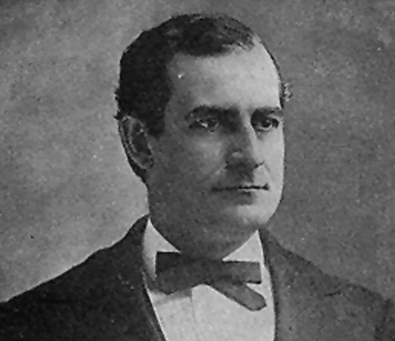
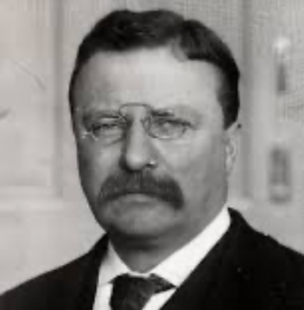
What Was to Be Done? Populism & Progressivism
Populists:
Who was to blame for inadequate opportunity?: the rich, the easterners, immigrants, and the bankers (Jews)… <Matthew 21:33-46>
Policies
Free coinage of silver at a ratio of 16-to-1; boost the money supply and lower interest rates…
Raise farm prices through cooperatives…
Antitrust to bust monopolies and restore competition…
Railroad and other forms of rate regulation…
Populist movement broken on the altar of racial animosity, & fear of socialism…
Progressives:
Progressives win the battle for mindshare in the history books: “malefactors of great wealth”, & c….
But they failed to make that much of a durable impact on American policy before World War I
But the availability of the Populist and Progressive agendas made the shift in American politics in response to the Great Depression a generation later rapid and substantial
Pretty much every left-of-center (and some right-of-center) initiative that had been proposed between 1885 and 1914 was then dusted off and given a try, in Franklin Delano Roosevelt’s New Deal
2:30 of audio in this slide
Notes:
Many of the middle class, especially the farmers, blamed the rich, the easterners, immigrants, and the bankers for what was going wrong with late nineteenth-century America.
The Populists of the 1890s sought the free coinage of silver at a ratio of 16-to-1 to boost the money supply, lower interest rates, and raise farm prices. They sought antitrust to bust monopolies and restore competition. They sought railroad and other forms of rate regulation to make sure that the largely-rural backbone of real Americans were not exploited by those in the cities with market power—whether rail barons, manufacturing monopolies, or bankers.
They blamed the eastern bankers, the gold standard, the monopolists, the immigrants, and—and this was what broke them as a political movement—the African-Americans. Rich Bourbon establishments in the south could and did win votes by segregating and disenfranchising African-Americans. And so southern American populism died as a political force.
The Progressives of the 1900s sought reforms to try to diminish the power of what they saw as a wealthy-would be aristocracy: the “malefactors of great wealth” in Theodore Roosevelt’s words. They sought an expanded government role to protect the environment, a progressive income tax, curbs on financial manipulation, and also to make the world safe for democracy. The Progressives got their chance when the assassination of William McKinley moved Republican Progressive Theodore Roosevelt out of the Vice Presidency—the powerless job dismissed by John Nance Garner as “a bucket of warm piss”—and into the White House in 1899, and then again when Roosevelt’s disgust at his successor Taft’s betrayal of Progressive values and sharp, corrupt Republican National Convention practice led him to throw the presidency to Democratic Progressive Woodrow Wilson in 1912.
However, these remained minority political currents in America. Voters typically elected Republican presidents—or that triangulating bastard Grover Cleveland—who were more-or-less satisfied with American economic and social developments, and who believed that “the business of America is business.” But the availability of the Populist and Progressive agendas was to make the shift in American politics in response to the Great Depression a generation later rapid and substantial. Pretty much every left-of-center (and some right-of-center) initiative that had been proposed between 1885 and 1914 was then dusted off and given a try, in Franklin Delano Roosevelt’s New Deal.

Slide 6
Catch Our Breath…
Ask a couple of questions?
Make a couple of comments?
Any more readings to recommend?
<>

